Slide 1
Sysadmin Essentials: Monitoring Log Files
Linux Week 3 // Day 3
Cybersecurity Boot Camp |

Slide 2
Today’s Goals
By the end of class, you will be able to:
Filter cron log messages using journalctl and rsyslog
Analyze and troubleshoot cron logs using logwatch.
Review the past three weeks of Linux

Slide 3
A Better Way to Administer Log Files

Slide 4
Journalctl
Amidst thousands of messages, filtering is an efficient way to monitor and troubleshoot problems.
journalctl and rsyslog are used to administer logs in this way.

Slide 5
Journalctl
journalctl is the utility that displays entries in the journal managed by the journald daemon.
Sys admins use journalctl to display and filter logs from various services.
Journal records are structured and indexed, allowing for output in different formats such as JSON.

Slide 6
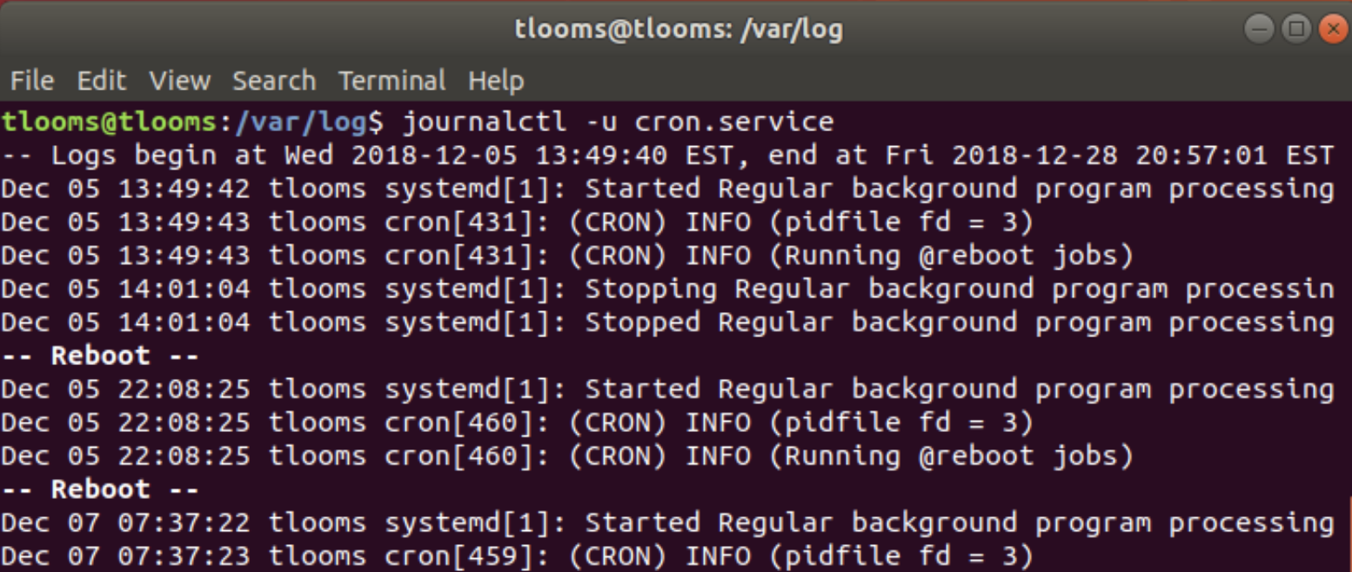
Demonstrating filtering for the cron service
The syntax for displaying logs from a particular service
in the journald log:

Slide 7
Demonstrating journalctl Filtering Options
One of the most important features of journalctl is its filtering capabilities.
All options for journalctl can be located using the man page.
Journalctl can filter logs based on a specific period of time (<date><time>) or using predefined strings (e.g., since, yesterday, now.)

Slide 8
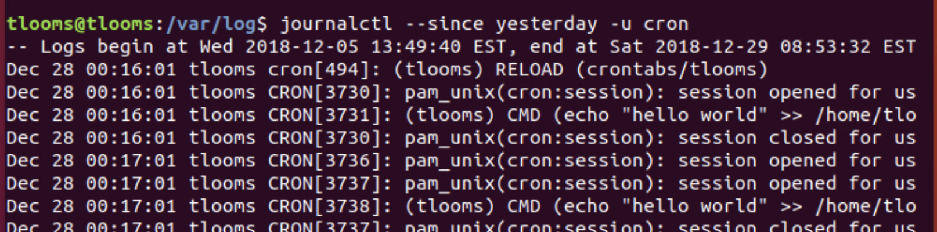
Demonstrate viewing cron Logs using Predefined Strings
Using “since” option and the “yesterday” keyword to filter log entries:

Slide 9
Demonstrate viewing cron logs by Time
Monitoring by time helps sys admins notice patterns over time:

Slide 10
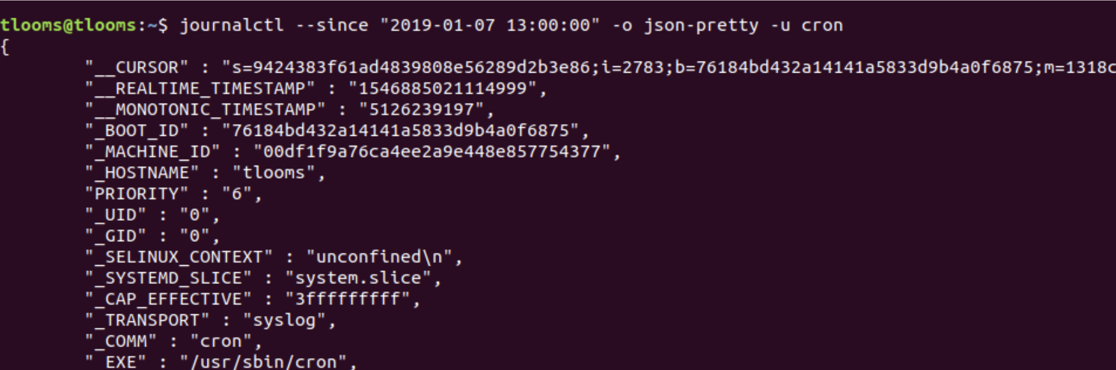
Formatting the Output
Another useful feature of journalctl is the ability to output logs in JSON format.
The logs can be used by a log management system.

Slide 11
Persist journalctl Logs
By default, logs are not maintained from system boot to system boot
To enable writing files to disk, set the storage field in etc/systemd/journald.conf to auto or persistent.
How can filtering be used to better monitor and administer a system?

Slide 12
Filtering Cron Logs with rsyslog
rsyslogd daemon filters messages into /var/log/cron.log in order to better filter cron logs
rsyslogd is the updated version of syslog and supports filtering by items like: service, message, process id.
Also supports local and remote logging

Slide 13

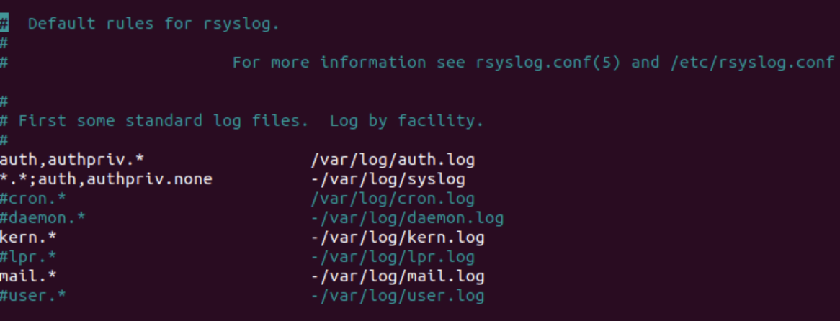
Filtering Cron Logs with rsyslog
[Instructor Demo]

Slide 14
Student Activity: A Better Way to Filter Log Files
Instructions
In these exercises, you use journalctl to filter logs for the cron service using combinations of options and keywords.
Open a terminal window on the Virtual Machine.
View the man page for journalctl.
Exercise 1:
Obtain the date / time on the system and view the log for cron up to that time.
Exercse 2:
View the log for cron without metadata for the last 20 minutes.
Exercise 3:
View the log for cron so that the latest enteries are display first.
Exercise 4:
Review and analyze the results from journalctl (for the system as a whole) to determine what activities are frequently logged?
Challenge:
Export the journal log for cron to exportlog.txt. This seralizes the data for backups or network transfer.

Slide 15
Monitoring Cron Logs with logwatch

Slide 16
Monitoring Cron Logs with logwatch
logwatch is another utility used to analyze logs and report on system activities
logwatch produces reports (digest) that can be filtered by service and may be viewed online or sent via email
Next, we will demonstrate how to manually view a digest for cron and how to manually send a digest via email

Slide 17
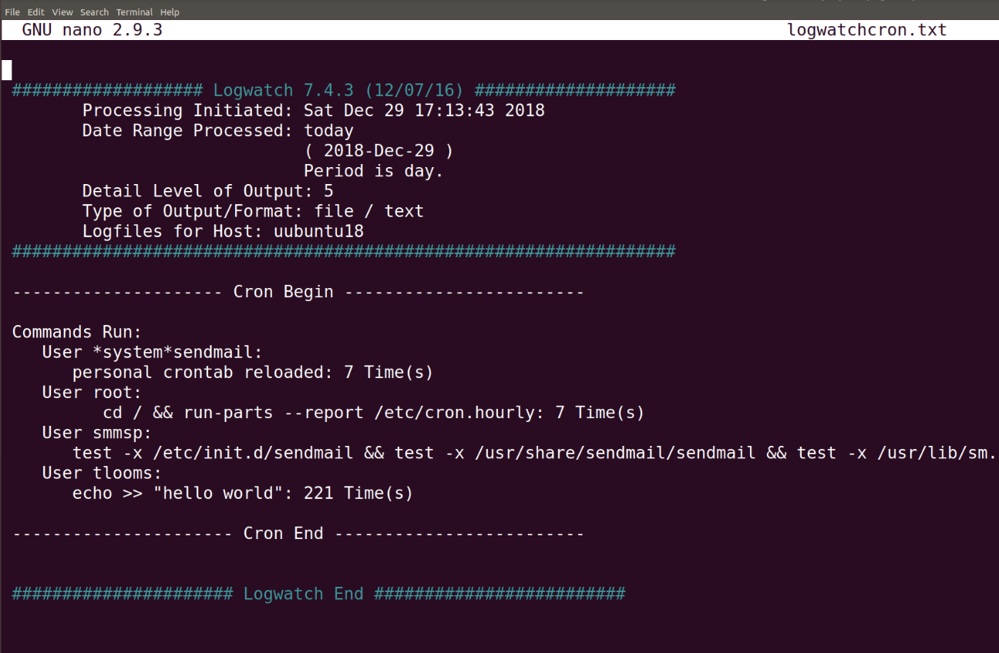
Demo 1
How to manually view a digest for cron:

Slide 18
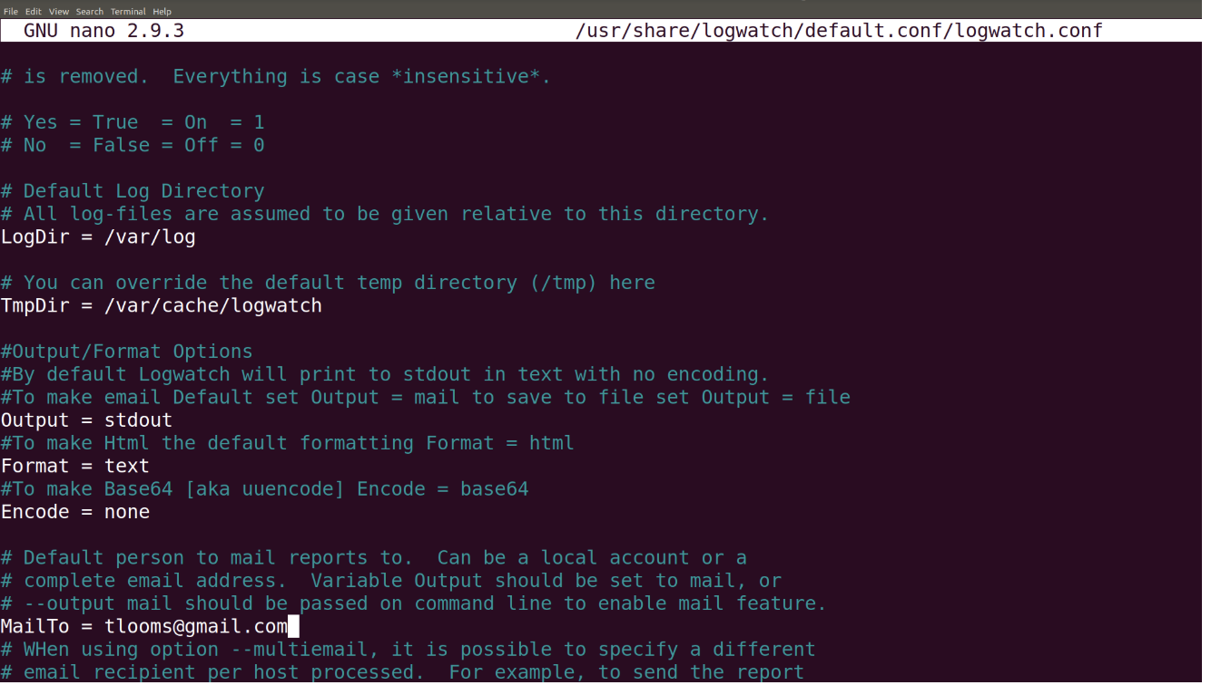
Demo 2
How to manually send a digest via email:

Slide 19
Student Activity: Monitoring Cron Logs with logwatch
Instructions
In this activity, you will display cron and system activities in the logwatch digest.
First display the man page for logwatch and review the options.
Exercise 1:
Manually send a digest for today's cron activity to mylogwatch.txt.
View the activities in the mylogwatch.txt file.
Exercise 2:
Use the digest SampleDigest to analyze system activity or errors.
Have TAs check to see how students are doing with the exercises.

Slide 20
Review Monitoring Cron Logs
Analyze the Sample Digest file for activity or errors
- Packages were upgraded (Did you do that?)
- Cron stats (Jobs seem to be running OK?)
- Kernel errors (What's happening with the system?)
- User Accounts (Any suspicious activity?)
- Disk space stats (Are we running out of space?)

Slide 21
Today’s Goals
By the end of class, you will be able to:
✅ Filter cron log messages using journalctl and rsyslog
✅ Analyze and troubleshoot cron logs using logwatch.
Review the past three weeks of Linux

Slide 22
Review Linux
Now we’ll be review the past three weeks of Linux, covering:
- Command-Line Fundamentals from Linux
- Advanced Bash from Linux 2
- Cron and Archives from Linux 3
Focus on what you find most challenging

Slide 23
End

